Slide 1
CreativEnvironment Rebrand ASM
DES 3020 - Group 5 JAMS

Slide 2


Logo
For the logo, we decided to use this one as we felt like it does well in displaying the purpose of the brand. The purpose is to help smaller companies, entrepreneurs, and others to grow their brand and expose them to a wider audience. The original logo didn’t really feel like it was doing that, and looked like it was for another purpose. The logo we chose was created in a way to help the client’s brand to stick out more than any competitors and that it welcomes everyone, in a vague way. Although the brand’s purpose was to mainly help women of color with business ventures and brand recognition, Vagueness was key so that it doesn’t sound like an exclusive brand. Green colors were the best choice as the color itself has a good feeling to it.
Logo Font: Montserrat Light
Tagline Font: Avenir Medium

Slide 3
Chosen Type Families
- Century Gothic Pro Bold: After some feedback, we decided to use Century Gothic Pro as it is similar to poppins and helps the main headers pop out more. It uses the #8C391B color as to pop out more compared to the rest of the text that will be presented in printed cards, or the websites.
- Century Gothic Pro Regular: This font was chosen mainly for normal text, since we felt like century gothic is more reliable for smaller text than other fonts.
- Century Gothic Regular: Lastly, this font will be used for the text links. Even though its not as bright as the first color, It will still be easy to spot with the font and the #7C7447
- PT Serif Bold: This font may not be as big as Century Gothing Pro Bold, It's still pretty readable and easy to see. It uses the #7C7447 color as for it to fit the theme of the brand. The Sub-header will utilize the font.
- PT Serif Regular: This font will be used for captions using the same color as the header that is using century gothic pro bold. Although It might look small, the colors make them stick out more than the normal text.

Slide 4
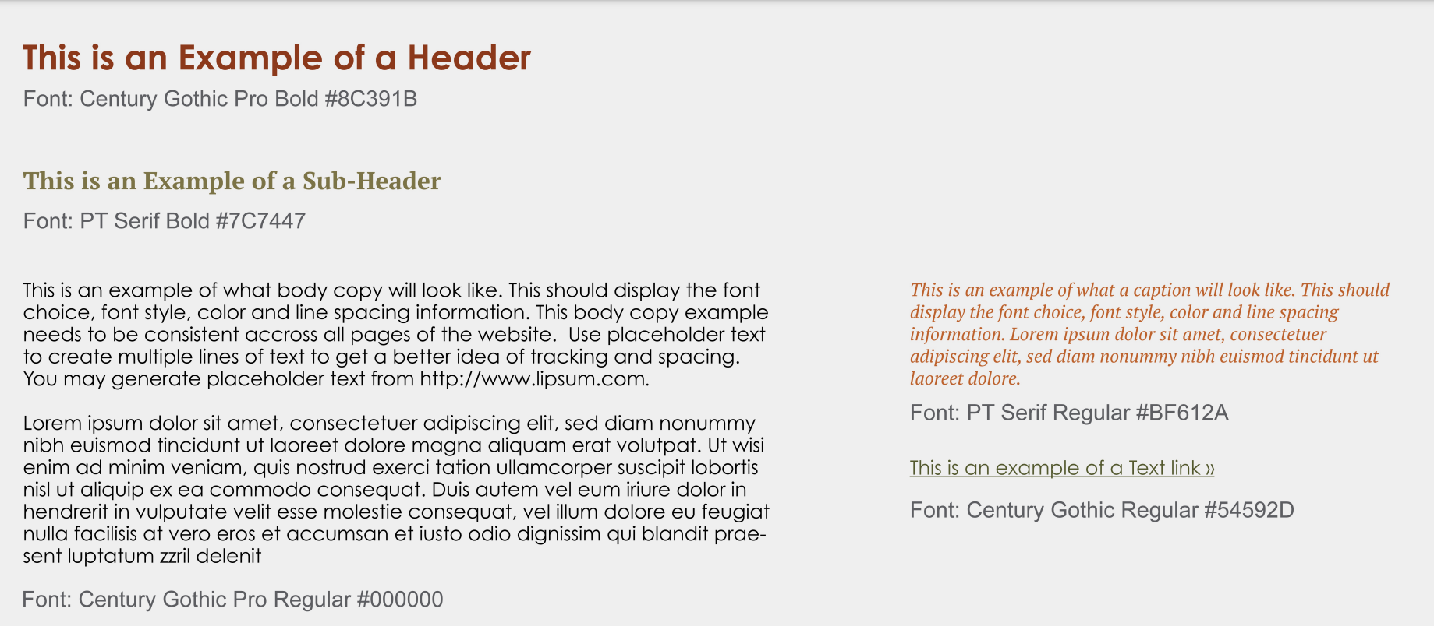

Slide 5





Color Palette
The greens are meant more as to give the audience a more welcoming experience and a place to “Grow” their brand.
The dark orange colors are meant to give a professional feeling since the brand is focusing on making sure these brands grow and do well, while also being vague on who the audience is for.
Black is just a color to bring everything together in an equilibrium, and making sure the colors don’t compete with each other.
RGB (140,57,27)
#8C391B
RGB (191,97,42)
#BF612A
RGB (242, 232, 179)
#F2E8B3
RGB (124,116,71)
#7C7447
RGB (84,89,45)
#54592D
RGB (53,53,53)
#353535

Slide 6



Correct Use of Logo
The logos on the left are free to use either with a black background or white as it helps the logo appear more visible. The white logo can be used with different colors as the logo and name can be visible, but should only be made using the provided color pallet to fit the feel of the brand.

Slide 7



Incorrect Use of Logo
The company name shouldn’t have its name on the left side or above the logo as it conflicts with the purpose of the logo, as it’s supposed to be the first thing you see.
Different colors for the logo makes it unpleasant to the viewer and makes the feeling of it uneven. It doesn’t give off a welcoming feeling and makes the look confusing.
Although the logo is visible, the direction is off as it’s using colors that conflict with the vision of the brand. The colors must be from the color pallet.

Slide 8
Logo orientations
The logo must be within a box this size, along with everything centered. For the horizontal version, everything must be centered as well, along with the box not touching any of the lettering. There should still be enough space between the border, logo and name of the company.

Slide 9


Super graphics, textures, and Patterns

Slide 10
Zoom Backgrounds

Slide 11


Slide 12


Slide 13


Slide 14

Digital Website Rebrand
Social Media Content
https://www.figma.com/proto/8ndosS0LVVNrw7zrxxUNNm/CreativEnvironment?page-id=0%3A1&type=design&node-id=15-69&viewport=944%2C546%2C0.85&t=5yeCvQIGFg7VWgOt-1&scaling=contain

Slide 15
Stationary Sets

Slide 16
